Slide 1
The Origins of Agile Software Development
A Module in Agile Fundamentals
Notes:
Hello, and welcome to The Origins of Agile Software Development, a module in Agile Fundamentals. This module is brought to you by ThoughtWorks Studios, makers of Mingle, Cruise, and Twist.

Slide 2
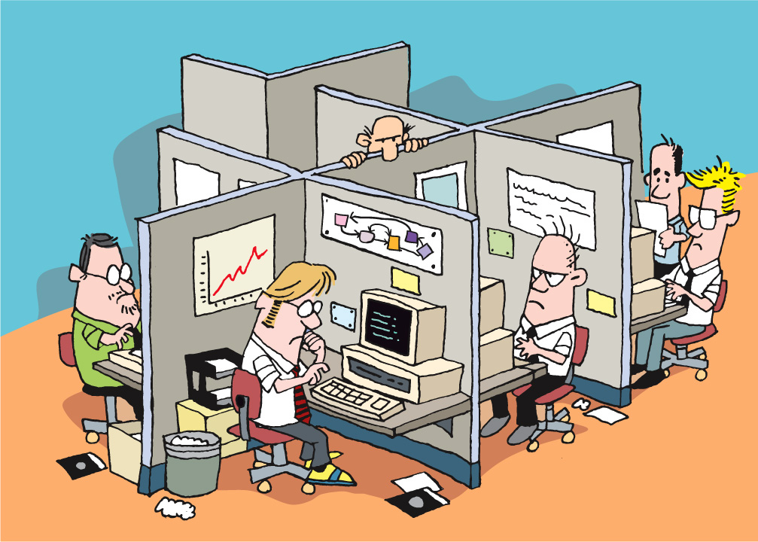
Notes:
In the beginning
Offices, cubicles, isolation
Strict hierarchy of roles – architects, designers, users, programmers, testers, PMs, BA, Build masters, tech writers
Rare to see crossover of specialties
Projects done in phases/stages.
One phase could not begin until the other was completed
[CLICK]
-------------------------------------------------------------------------------------------------------------
In the beginning, there were offices and cubicles and isolation and darkness. Those who created program code lived within a strict hierarchy, and were known as Architects, Designers, Users, Programmers, Testers, Project Managers, Build Masters, and Technical Writers. It was the rare individual who could cross over from one area of specialty to another. Growing into a more senior role, having more responsibility, required lengthy periods of apprenticeship and hardship. This was a system known as “Waterfall”. Projects were done in “phases” or “stages”, and no phase could begin until the preceding phase was done.
Imagine that you were a tester, back in those days. You’d spend weeks or months reading the specs, planning, organizing your thoughts, all in the service of being able to start your “real” work when the architects, designers, and programmers were done with their jobs. You didn’t really talk to the others all that much, because they had their heads down, busily doing their jobs in their phases. Interruptions were not welcome.
In order to accomplish anything requiring more than one person, a meeting would be called. People arrived late and unprepared. Resenting meetings, some people paid little attention and hurried to escape. Fortunately, back in those days, there were no notebook computers or iPhones, so those forced to attend meetings had nothing to distract them. Meetings tended to be focused around passivity – a presenter presented, and everyone else tried to stay awake. The ideas of participation and collaboration tended to be marginalized.
Imagine the times: massive computer terminals, hardwired to mainframes and “super-microcomputers”, running proprietary operating systems or UNIX. No PCs or Macs, no notebooks, no monitors and ergonomic keyboards, no mice. And no Internet! Truly the Dark Ages.
From the second slide:
Analysts
Spent weeks or months creating detailed specifications for an entire system
Developers
Individually estimated portions of the application
PMs
Planning to the nth detail
From the third slide:
Testers
Spent weeks or months reading specs
Planning, organizing your thoughts
So you could start when the architects, designers, developers were done
Heads down development
No talking to others regularly
Interruptions not welcome
[CLICK]
-------------------------------------------------------------------------------------------------------------
Imagine that you were a tester, back in those days. You’d spend weeks or months reading the specs, planning, organizing your thoughts, all in the service of being able to start your “real” work when the architects, designers, and programmers were done with their jobs. You didn’t really talk to the others all that much, because they had their heads down, busily doing their jobs in their phases. Interruptions were not welcome.
From fourth slide:
Meetings required to resolve issues, answer questions
People arrive late
Not focused
No iphones or laptops to distract back then
Passive meetings – presenter, listeners
Little collaboration, participation
Exaggerating to make a point

Slide 3
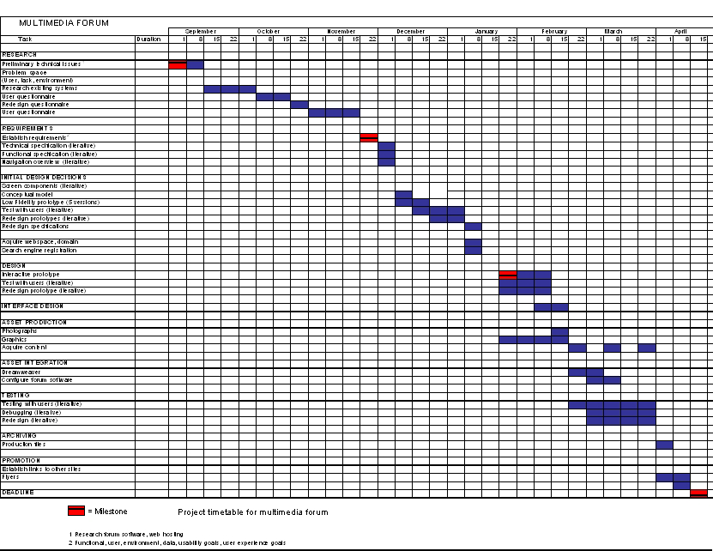
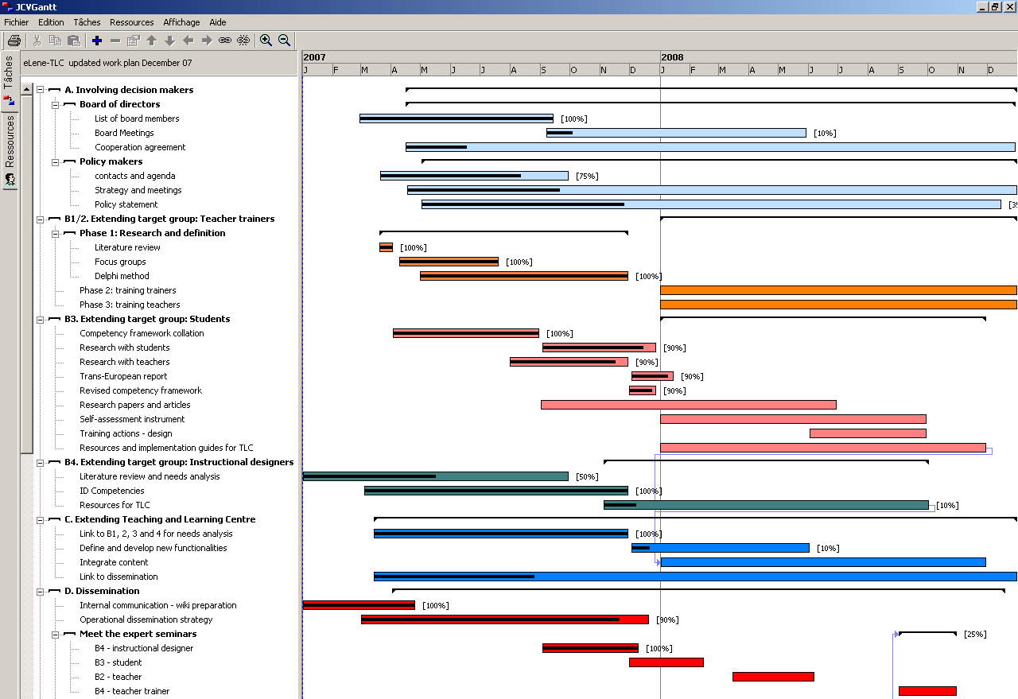
Notes:
Projects planned to the detail
What to build - pieces
In what order
How long it would take
How to assemble the pieces at the end
Result
Massive planning documents
Wrong before you even started
Contracts were drawn from these plans
Problem is……
How could u know what u didn’t know?
How could u plan for changing business requirements?
Many failed projects called ‘Shelfware’.
---------------------------------------------------------------------------------------------------------------
Projects were planned down to the tiniest detail. Project managers and their teams spent substantial time figuring out exactly what they were building, what pieces to build in what order, how long it would take for each piece, and how they were going to assemble them.
The result? Massive planning documents that were generally wrong before they were finished.
After all, how could they know all the things that could go wrong? How could they know what they didn’t know? How could they know what they would learn and how business circumstances and economy and people would change during the course of their development?
They couldn’t. And yet, they tried and tried.
This gave birth to the term “shelfware”.

Slide 4

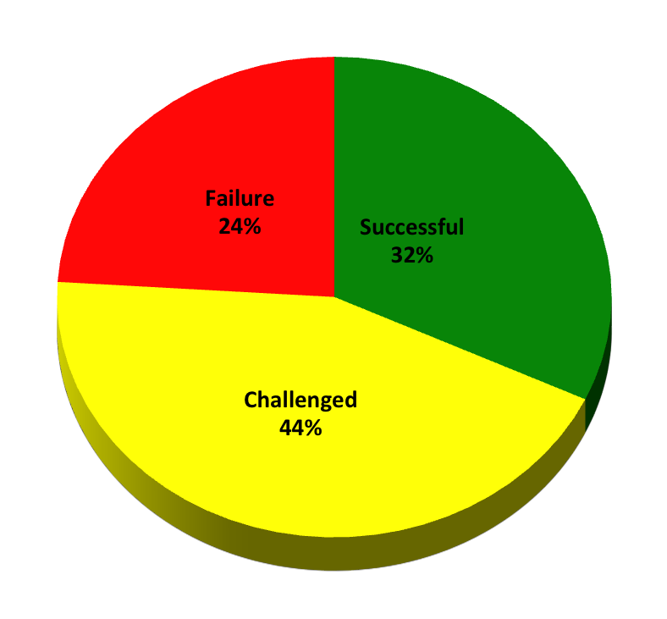
Software project outcomes
The Standish Group CHAOS Summary 2009
Notes:
Reports are periodic – not annual
Only 34% are UNQUALIFIED success

Slide 5
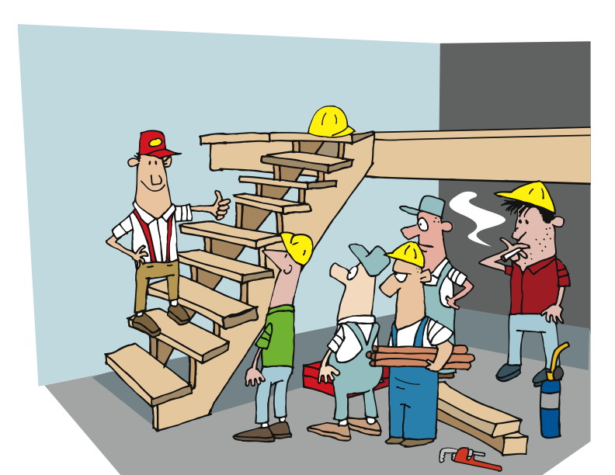
Notes:
That approach came from
Engineering
Manufacturing
Clearly defined functionality requires knowledge of everything up front.
-----------------------------------------------------------------
Much of this approach came out of the realms of engineering and manufacturing. After all, when you’re building a thing with clearly defined functionality, it’s possible – maybe even required – to know everything you’re going to do up front.

Slide 6
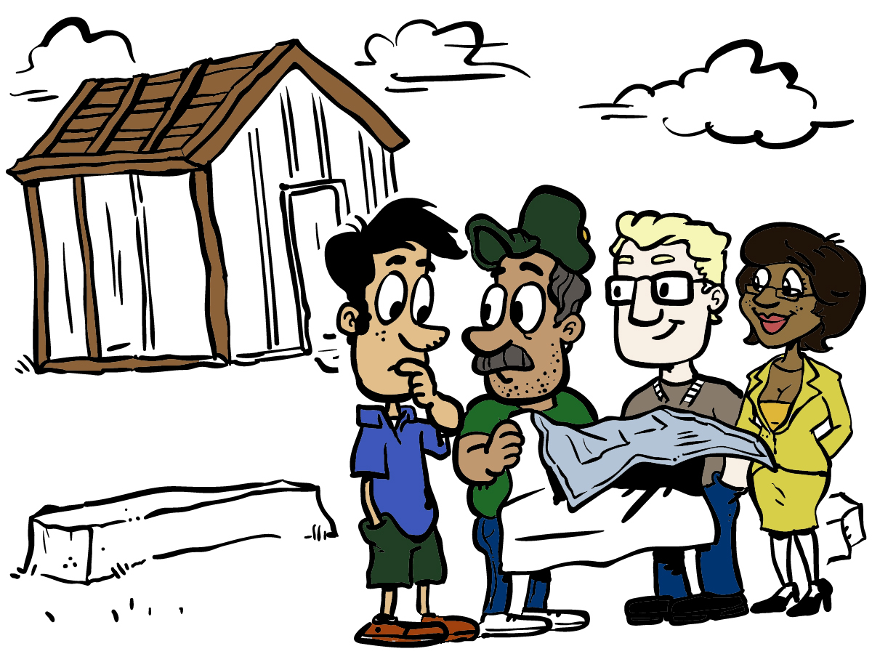
Notes:
Like Building a house.
Never finishes on time.
Materials are on back order
Team is late finishing up another project
Designer misunderstands the usage of a room
Schedules slip
Result may not match expectations
-----------------------------------------------------------------------------------
Like building a house. Of course, those of us who have paid someone to build a house know that they never finish on time, don’t we?

Slide 7
Notes:
NASA – example of successful software engineering
High complexity, large scale, many people involved, many decisions
Lives depend on the quality of the applications.
At what cost does NASA achieve this high quality?
-------------------------------------------------------------------------------------------
NASA is always used as a great example of successful (and sometimes unsuccessful) examples of software engineering at work. The challenges and issues rings true with a lot of places – high complexity, large scale operations, lots of people and decisions made that have a long lasting effect on a project.
Let’s look at how NASA’s software processes achieve high quality. Then we’ll take a look at the cost to achieve this measure. It’s important for us to be aware that Agile is not about dropping quality. In fact, quality a key component. It’s really more about finding a better balance between the quality and the cost used to achieve it.

Slide 8
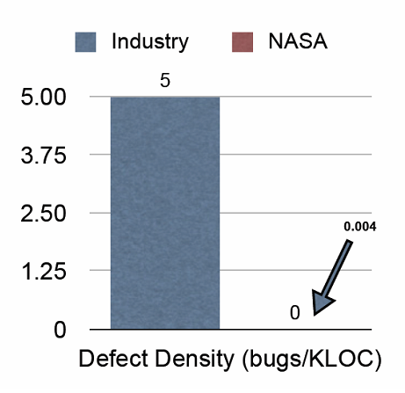
NASA’s Defect Density
Pretty good, right?
Notes:
Let’s compare the defect count of the Industry apps to NASA apps
Industry = 5 defects / kLOC
NASA = 4 defects/ MLOC
At what cost?
---------------------------------------------------------------------------------------------------------------------------------
NASA did a great job of producing software with few or no bugs. After all, lives depended on their work. Many lives.
As you can see from this chart, the industry average was five defects per thousand lines of code, whereas NASA’s was four defects per MILLION lines of code. That’s three orders of magnitude difference. Remarkable! That’s something that any organization would envy, right?
But…

Slide 9
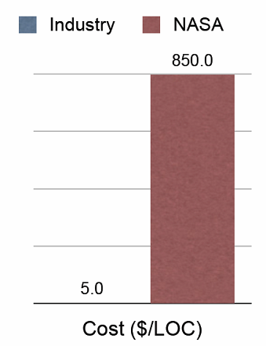
NASA’s Defect Density
Another data point
Notes:
Quality comes with a cost
Any 2 of time, Cost, Quality
Fast+cheap = low quality
High quality + low cost = not fast
[CLICK]
Industry = $5 / LOC
NASA = $850 / LOC
Most private organizations can’t accommodate
---------------------------------------------------------------------------------------------------
That quality came with a cost. In the software development and information technology professions, the common offering is this: you can have any two of time, dollars, and quality. That is, you can have high quality and low cost, but don’t expect it fast. Or you can have it fast and cheap, but the quality won’t be there. Isn’t that a sad statement for a profession that included the word “engineering” in the name of their profession?
So let’s take a look. As we saw, NASA achieved unheard of quality in their software.
CLICK
The cost was significant. Notice here that while the industry average cost was five dollars per line of code, NASA’s cost was EIGHT HUNDRED FIFTY DOLLARS per line of code. While a government agency might be able to argue for this kind of expense, private industry could not.

Slide 10
100,000 x $850 = $85,000,000 EIGHTY-FIVE MILLION DOLLARS
Notes:
Your company produced software with 100,000 LOC
x $850 / LOC
= $85M
Not going to fly.
So how did all of this chaos turn into AGILE.
---------------------------------------------------------------------------------------------------------------
Imagine that your company was producing software with a measly one hundred thousand lines of code. Let’s see – one hundred thousand times eight hundred fifty is EIGHTY-FIVE MILLION DOLLARS. How many companies can afford that kind of investment? Pretty close to none.
Understanding this led some practitioners to start thinking about different – preferably better – ways of doing things.

Slide 11
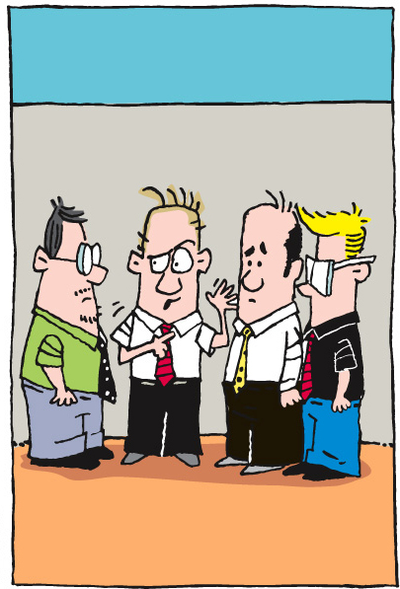
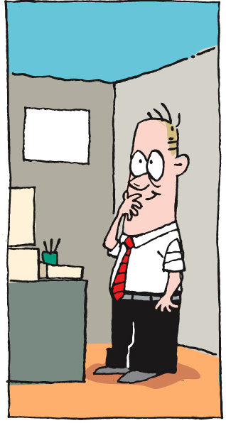
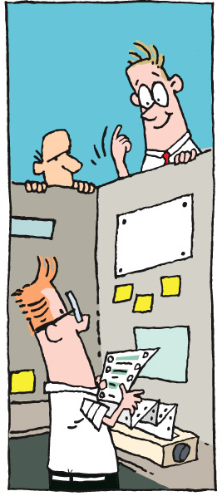
Notes:
1980’s early 1990’s
Ken Schwaber was frustrated
Tired of waiting to find out details
Tired of calling meetings for answers
Tired of projects past due
Tired of missing the mark on business value
Tired of heavy documentation
[CLICK] Find a way to…….
How to communicate more effectively, sooner, quicker
Talk to each other every day
Find ways to deliver sooner, better results, lower costs
[CLICK]
Ken and colleagues – SCRUM
Some comments about SCRUM from his web site
---------------------------------------------------------------------------------------------------------------
In the 1980’s and early 1990’s, there was this guy named Ken Schwaber. Ken was frustrated with the status quo. He was tired of having to wait to find out what was going on. He was tired of having to call – or attend – “formal” meetings to share information. He was tired of waiting for the waterfall to reach his “level”.
Ken thought about this a lot. After all, this was important stuff. The idea that co-workers could communicate more effectively, sooner, quicker, and easier just seemed to make sense. Ken started to wonder why no one was finding a way to do this. Why not talk to each other every day? In fact, why not find multiple ways for project and product teams to deliver sooner with better results and lower costs?
[Reference: http://www.controlchaos.com/about/?SID=8ef7eb5b2a069a2710abef27d02c851f&SID=7da824062baf60b8e78ec5f99836f092 ]
Ken, working with some colleagues, came up with an approach that he called “Scrum”. Here’s some information about Scrum from Ken Schwaber’s web site:

Slide 12
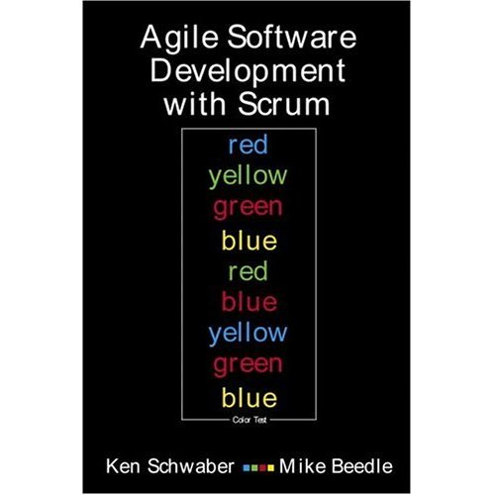
…a wrapper for existing engineering practices
…an agile process to manage and control development work
…a process that controls the chaos of conflicting interests and needs
…a way to improve communications and maximize cooperation
…a way to maximize productivity
…scalable from single projects to entire organizations. Scrum has controlled and organized development and implementation for multiple interrelated products and projects with over a thousand developers and implementers
…a way to detect and cause the removal of anything that gets in the way of developing and delivering products
…a way for everyone to feel good about their job, their contributions, and that they have done the very best they possibly could
…a team-based approach to iteratively, incrementally develop systems and products when requirements are rapidly changing
Notes:
Incremental, iterative process
Developing any product
Or Managing any work
Produces potentially shippable set of functionality at the end of each period
[CLICK] through each bullet
1st referred to in "The New Product Development Game", published in Harvard Business Review in 1986,
Later elaborated in "The Knowledge Creating Company" both by Ikujiro Nonaka and Hirotaka Takeuchi, published by Oxford University Press in 1995.
First presented to the Object Management Group in 1995
Based on collaboration with DuPont Advanced Research Facility
The Scrum process is fully described in a book
CLICK
from Ken Schwaber and Mike Beedle, titled Agile Software Development with Scrum.
--------------------------------------------------------------------------------------
Scrum is an iterative, incremental process for developing any product or managing any work. It produces a potentially shippable set of functionality at the end of every iteration. It's attributes are:
[CLICK] Scrum is an agile process to manage and control development work.
[CLICK] Scrum is a wrapper for existing engineering practices.
[CLICK] Scrum is a team-based approach to iteratively, incrementally develop systems and products when requirements are rapidly changing
[CLICK] Scrum is a process that controls the chaos of conflicting interests and needs.
[CLICK] Scrum is a way to improve communications and maximize co-operation.
[CLICK] Scrum is a way to detect and cause the removal of anything that gets in the way of developing and delivering products.
[CLICK] Scrum is a way to maximize productivity.
[CLICK] Scrum is scalable from single projects to entire organizations. Scrum has controlled and organized development and implementation for multiple interrelated products and projects with over a thousand developers and implementers.
[CLICK] Scrum is a way for everyone to feel good about their job, their contributions, and that they have done the very best they possibly could.
CLICK
Scrum as applied to product development was first referred to in "The New New Product Development Game", published in Harvard Business Review in 1986, and later elaborated in "The Knowledge Creating Company" both by Ikujiro Nonaka and Hirotaka Takeuchi, published by Oxford University Press in 1995.
Based on their ideas and research in process theory performed in collaboration with DuPont Advanced Research Facility, Scrum was first formulated and presented to the Object Management Group in 1995.
The Scrum process is fully described in a book
CLICK
from Ken Schwaber and Mike Beedle, titled Agile Software Development with Scrum.

Slide 13
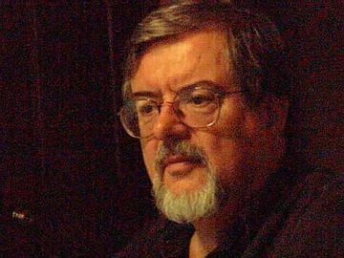
Notes:
About the same time Kent Beck was also thinking about failed software projects
Convinced there were more effective ways
Believed that working in isolation was not ideal
1999 Kent wrote Extreme Programming Explained
Known as XP
Created by Kent and Ron Jeffries during C3 project – Comprehensive Compensation System
Kent became the project leader in March 1996
Refined the practices on that project
Led to the book
C3 cancelled in 2000 due to acquisition
---------------------------------------------------------------------------------------------
At somewhat the same time, in the mid- to late-1990’s, a fellow named Kent Beck was also thinking about how software projects work. Kent was convinced that there were more effective ways for software developers and testers to do their jobs. He thought that working in isolation, with minimal interaction, was not the ideal. Rather, he conceived of different ways of working (which we’ll talk about more later) that he believed would produce better software with fewer defects.

Slide 14
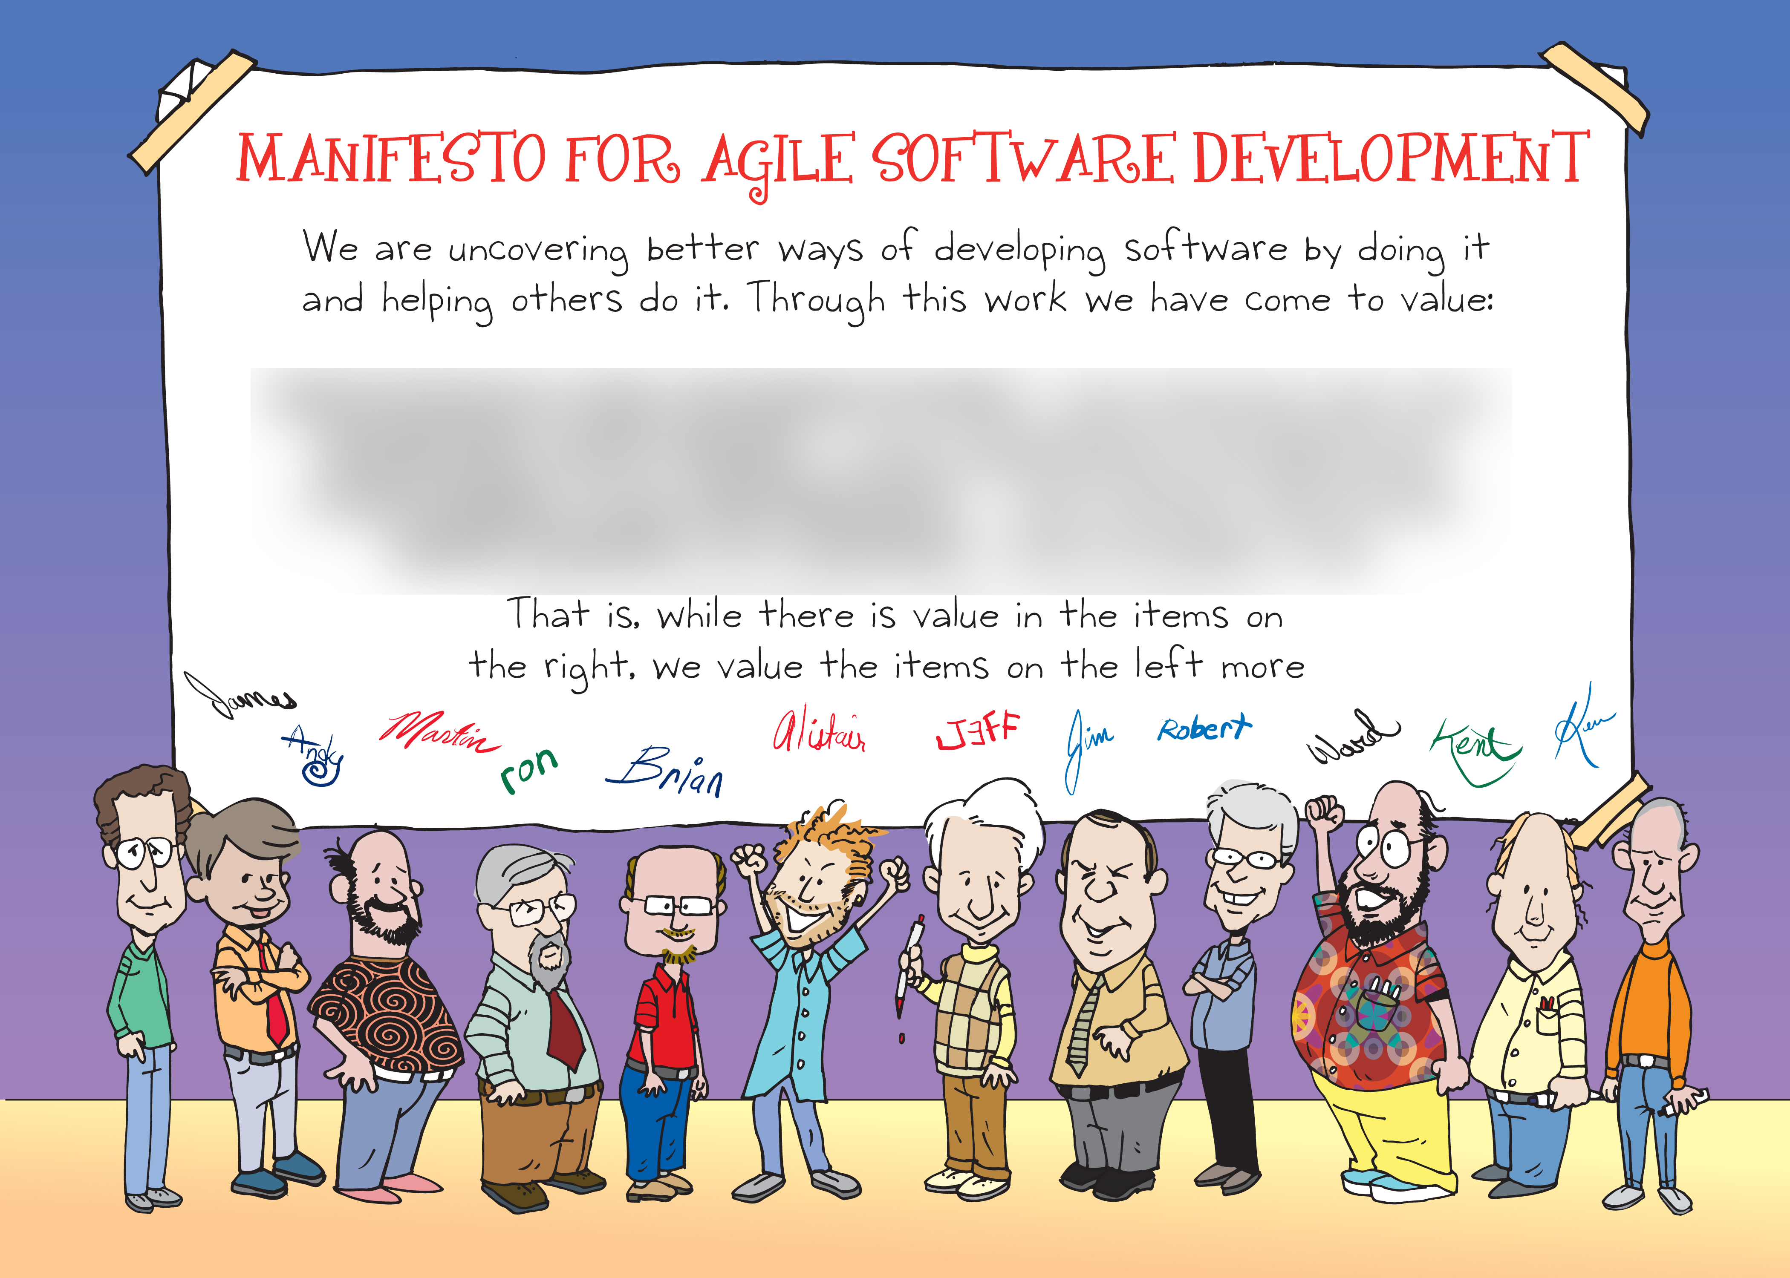
Notes:
Feb 2001
The Lodge at Snowbird resort, mountains of Utah
Talk, ski, relax, find common ground
Emerged the Agile – Software Development – Manifesto.
[CLICK]
------------------------------------------------------------------------------------------------
The result of the thinking and activities of folks like Ken Schwaber, Kent Beck, Ward Cunningham, Martin Fowler, Alistair Cockburn, and others was a document called A Manifesto for Agile Software Development.
A group of these folks – the thinkers and doers and experimenters – got together on February 11-13, 2001, at The Lodge at Snowbird ski resort in the Wasatch mountains of Utah, to talk, ski, relax, and try to find common ground - and of course, to eat. What emerged was the Agile -Software Development- Manifesto. Representatives from Extreme Programming, SCRUM, DSDM, Adaptive Software Development, Crystal, Feature-Driven Development, Pragmatic Programming, and others sympathetic to the need for an alternative to documentation driven, heavyweight software development processes convened.

Slide 15
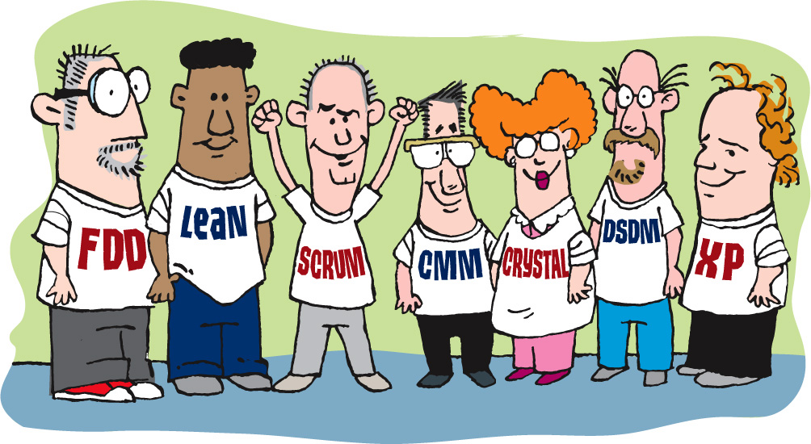
Notes:
There were 17 individuals at the ski lodge. Let’s take a quick look at them and how they are still contributing to the practice of software development.
Then we’ll get into more detail about the manifesto.
------------------------------------------------------------------------------------
Now, a bigger gathering of organizational anarchists would be hard to find, so what emerged from this meeting was symbolic - a Manifesto for Agile Software Development - signed by all participants. The only concern with the term agile came from Martin Fowler (a Brit, for those who don’t know him) who allowed that most Americans didn’t know how to pronounce the word ‘agile’.
(taken from http://www.agilemanifesto.org)
[Resource: http://www.agilemanifesto.org/history.html]
Many of these folks are legendary today, including:

Slide 16

Notes:
Kent Beck
Co-Creator of Extreme Programming
Author of “Extreme Programming Explained” and
“Test-Driven Development by Example”
---------------------------------------------------------------------
Kent Beck, who is known as the creator of Extreme Programming, with Ron Jeffries, and author of “Extreme Programming Explained” and “Test-Driven Development by Example”

Slide 17

Notes:
Ron Jeffries,
co-developer of the eXtreme Programming methodologies
author of “Extreme Programming Adventures in C#”,
co-author of “Extreme Programming Installed”,

Slide 18
Notes:
Ken Schwaber,
who is best known as the co-creator of Scrum, with Jeff Sutherland,
author of “Agile Project Management with Scrum” and
“The Enterprise and Scrum”,
co-author of “Agile Software Development with Scrum” with Mike Beedle

Slide 19
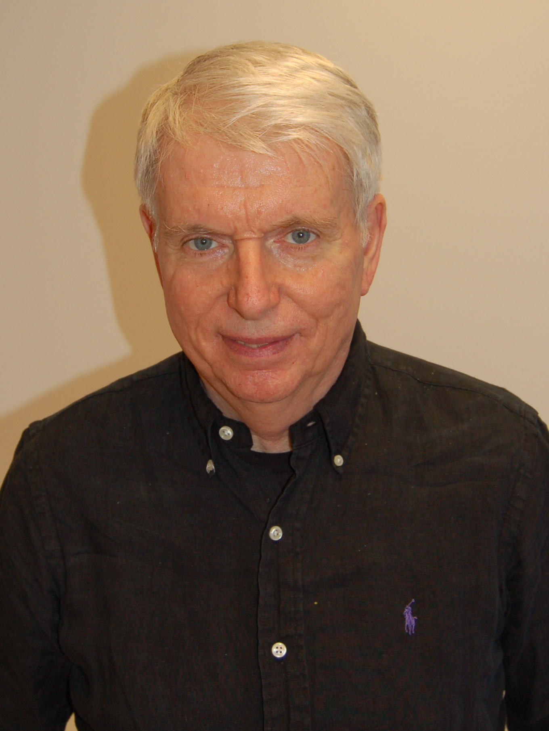
Notes:
Jeff Sutherland is the co-creator of Scrum, with Ken Schwaber

Slide 20
Notes:
Mike Beedle,
co-author of “Agile Software Development with Scrum” with Ken Schwaber

Slide 21

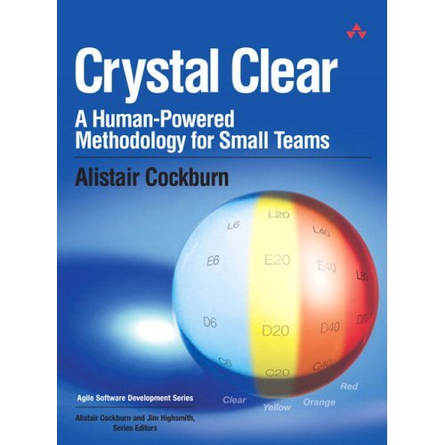
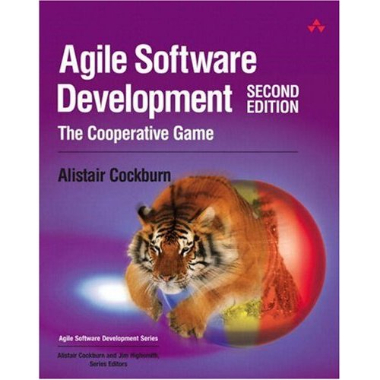
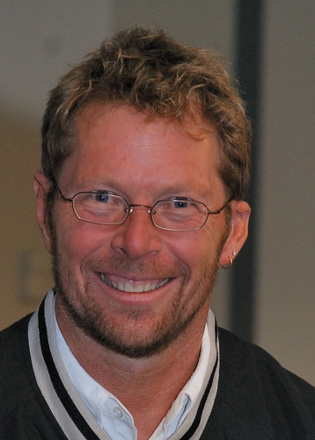
Notes:
Alistair Cockburn,
Author of “Agile Software Development: The Cooperative Game”,
“Writing Effective Use Cases”,
“Crystal Clear: A Human-Powered Methodology for Small Teams”

Slide 22
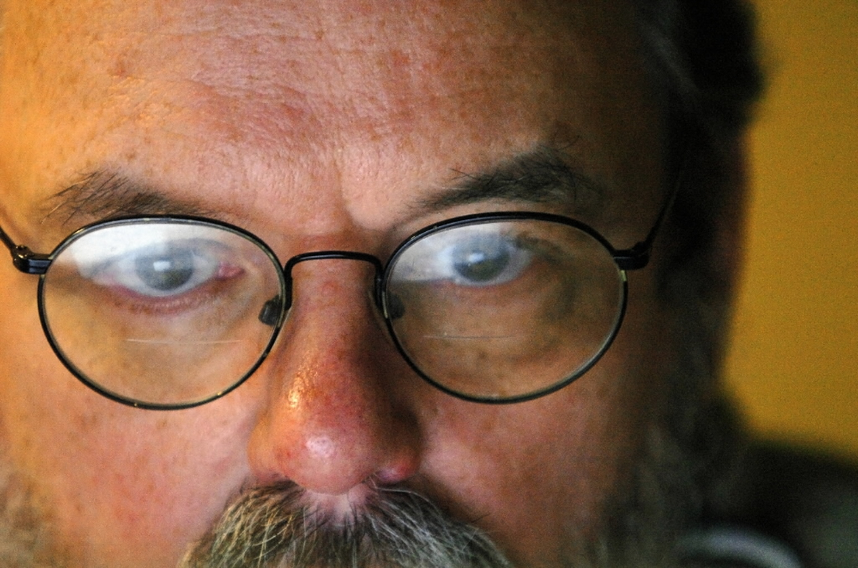
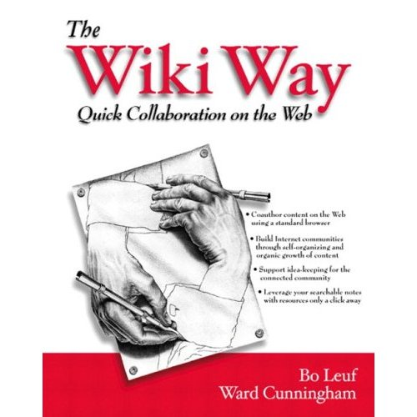
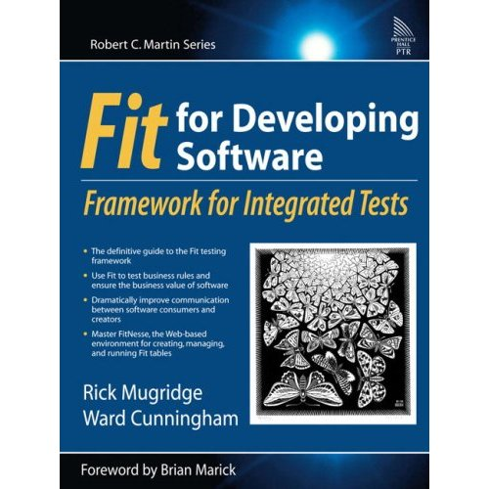
Notes:
Ward Cunningham,
Created the first wiki,
Co-author of “The Wiki Way: Quick Collaboration on the Web”,
Author of “Fit for Developing Software: Framework for Integrated Tests”.
Fit was created with TW on our 1st agile project.

Slide 23
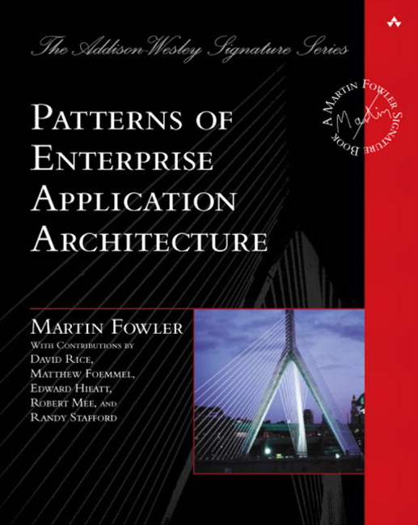
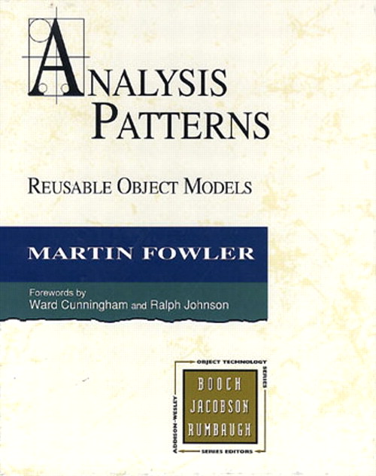

Notes:
Martin Fowler,
Chief Scientist of ThoughtWorks,
author of “Patterns of Enterprise Application Architecture”
and “Analysis Patterns: Reusable Object Models”,
co-author of “Refactoring: Improving the Design of Existing Code” with Kent Beck and others, and more

Slide 24
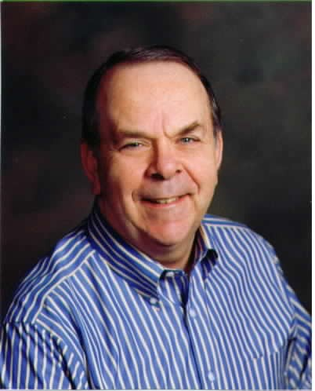
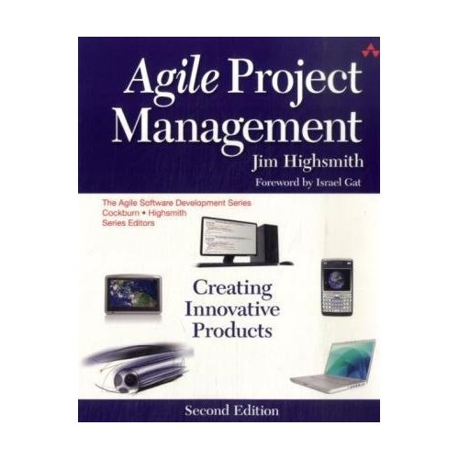
Notes:
Jim Highsmith,
author of “Agile Project Management: Creating Innovative Products”,
“Agile Software Development Ecosystems”, and more.
Jim is also the founder of the Agile Project Leadership Network, and currently serving as its co-president.

Slide 25

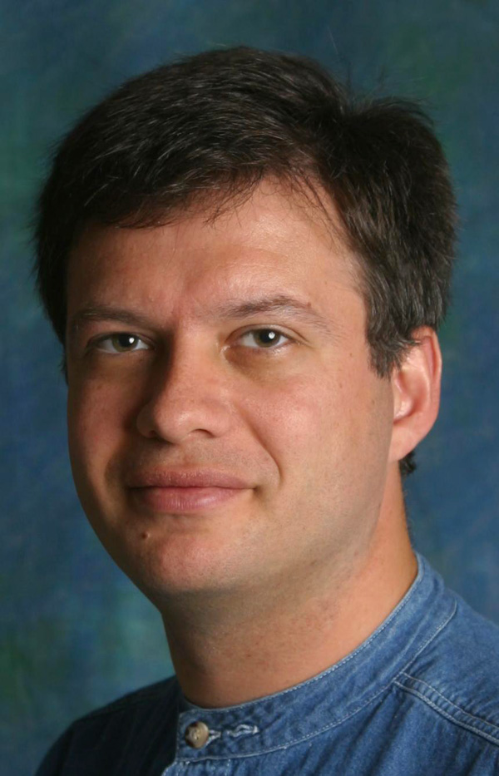
Notes:
Andrew Hunt
co-founder of “The Pragmatic Programmers” and
co-author of “The Pragmatic Programmer: From Journeyman to Master”,
both with Dave Thomas

Slide 26
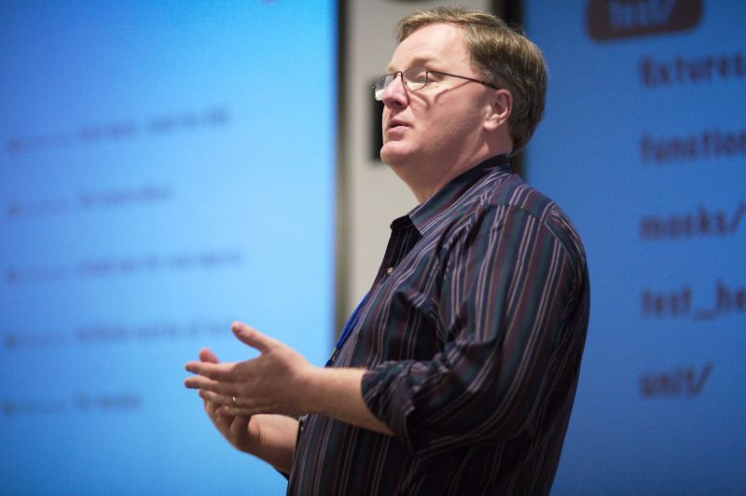
Notes:
Dave Thomas is a
co-founder of “The Pragmatic Programmers” with Andy Hunt, and
co-author of “The Pragmatic Programmer: From Journeyman to Master”

Slide 27
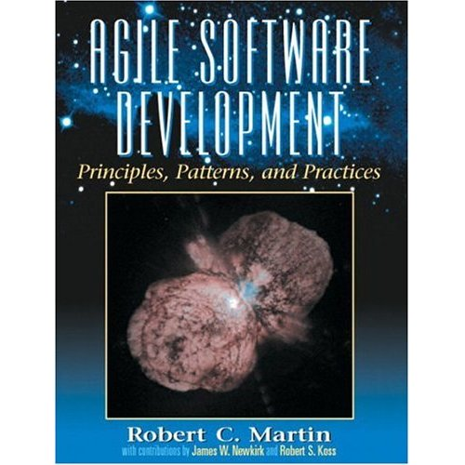
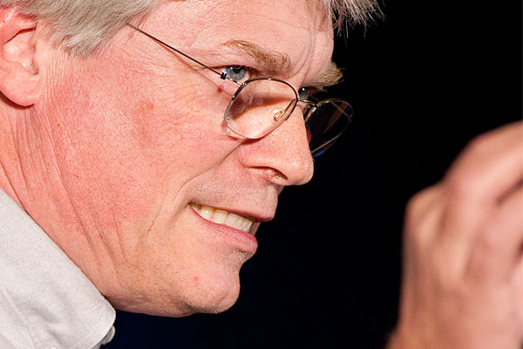
Notes:
Robert C. Martin, “Uncle Bob” Martin,
author of “Agile Software Development, Principles, Patterns, and Practices”,
“Agile Principles, Patterns, and Practices in C#”,
“Clean Code: A Handbook of Agile Software Craftsmanship”

Slide 28
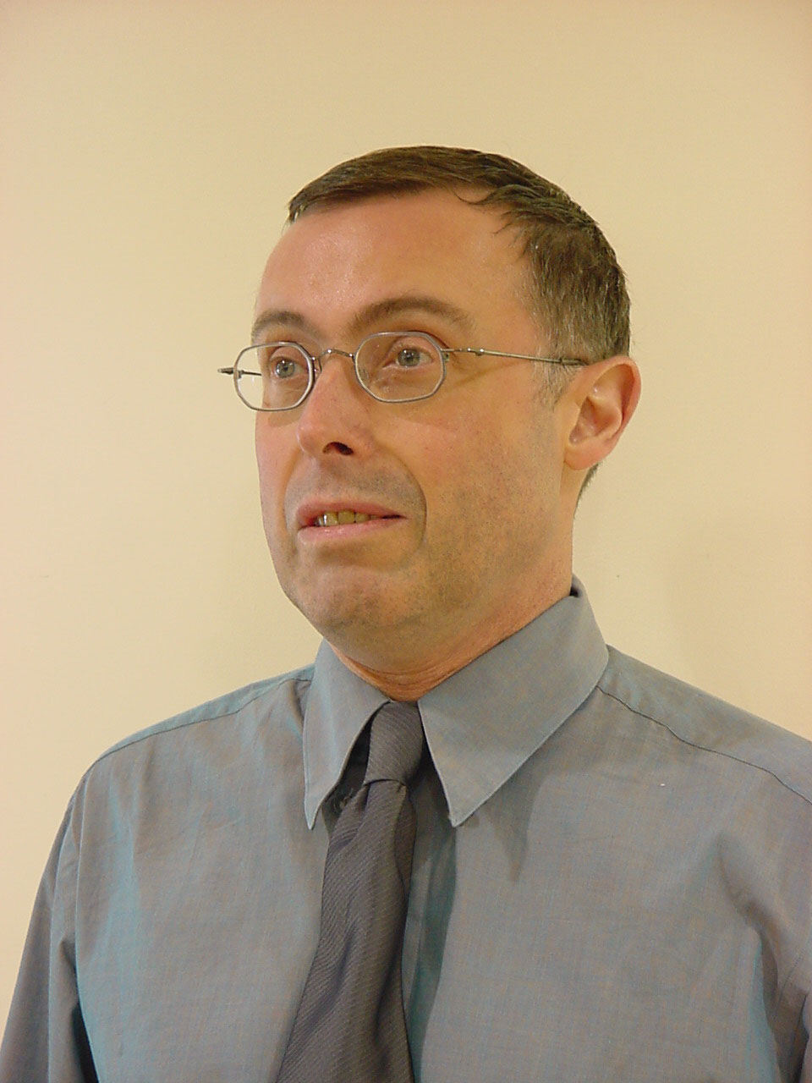
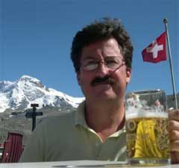
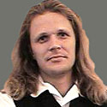
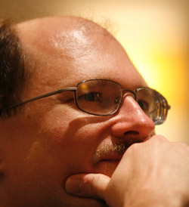
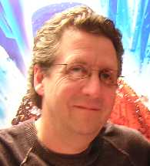
Notes:
Steve Mellor
developer of the Shlaer-Mellor method of analysis and design
James Grenning
Created Planning poker
Arie van Bennekum,
Works for the The Vision Web
Responsible for DSDM projects.
He is member of the DSDM Netherlands board and active as an examiner.
John Kern –
Since June 2004, Jon Kern works with OptimalJ at Compuware.
Kern was an early adopter of object-oriented programming (C++ in the late 80s/early 90s) and the Coad Methodology
Kern is also a co-author on Java Design 2ed with Peter Coad
Brian Marick,
author of “The Craft of Software Testing: Subsystems Testing Including Object-Based and Object-Oriented Testing”,
“Everyday Scripting with Ruby: For Teams, Testers, and You”,
“Programming Cocoa with Ruby: Create Compelling Mac Apps Using RubyCocoa”
------------------------------------------------------------
Steve Mellor, who is a computer scientist, developer of the Shlaer-Mellor method and signatory to the Agile Manifesto. He was chief scientist of the Embedded Systems Division at Mentor Graphics. He has contributed to the Object Management Group, chairing the consortium that added executable actions to the UML and the specification of Model Driven Architecture. He is also chairing the advisory board of the IEEE Software magazine.

Slide 29
The Agile Manifesto
Following a Plan
Processes and Tools
Contract Negotiation
Working Software
Comprehensive Documentation
Individuals and Interactions
Customer Collaboration
Responding to Change
Notes:
Now for a little bit of fun. You each have a worksheet that contains the key concepts that make up the Manifesto. There’s a template on those worksheets, showing how the ideas go together. Let’s take a few minutes to see if we can figure out what the signers of the Manifesto had in mind.
Building the Agile Manifesto
Don't just simply present the agile manifesto. The students will learn more if they have an opportunity to build it. Ensure that your flip chart has the four empty slots for all the statements as well.
Hand out copies of the empty Agile Manifesto (see Student's Handout). Feel free to ask students to work together in pairs or individually. Explain the manifesto is used as a guide for values and that everything on the list is important and we're trying to understand what factors might influence the decisions we make.
Give them five minutes to fill out their form. Build up the manifesto based on everyone's input and discuss why one item appears on one side, and why they are trade offs.

Slide 30
Notes:
What do these ideas mean to us?
Something over something else
Not instead of
Both sides have value
Items on the right have value BUT
We value the left items more
-------------------------------------------------------------------------------
Let’s talk for a few minutes about the four key ideas these folks wrote into the Agile Manifesto, and what they mean to us.
First, we’ll consider the wording. Note that every one of these is phrased as something over something else. That’s not instead of or is better than. No, it’s over. That means that both sides of the statement have value, and that the folks who authored the Manifesto were expressing a preference for one over the other.
In fact, what you don’t see on this illustration is the sentence that comes after the four points in the manifesto: “That is, while there is value in the items on the right, we value the items on the left more. “
Now let’s look at them one by one…

Slide 31
Notes:
Individuals and Interactions over Processes and Tools
TW supports tools – creator of tools
People talking is more important to insuring the success of a project
Process and tools should encourage and facilitate conversation
Robert Frost said
“I am a writer of books in retrospect. I talk in order to understand; I teach in order to learn.”
Ernest Hemingway said
“When people talk, listen completely. Most people never listen.”
---------------------------------------------------------------------------------------
As a toolmaker, clearly ThoughtWorks Studios believes that there is value in tools and the processes that they support. In fact, all of us use tools every day in our jobs and our lives. Whether it’s a computer, keyboard, mouse, and monitor, or a toaster or a coffee maker, tools make our lives easier. What the authors of the Agile Manifesto were focusing on, however, was their belief that it is people, and the interactions between people, that are more important in ensuring the success of projects. People talking to people, and people as skilled craftspeople and experts in their fields – these are the things to focus on.
Robert Frost said “I am a writer of books in retrospect. I talk in order to understand; I teach in order to learn.” That goes right to the heart of Individuals and Interactions. Agile teams are always teaching each other and learning from each other. Tools and processes are there to free them to do these and other things, not to be the focus of their efforts.
And Ernest Hemingway said “When people talk, listen completely. Most people never listen.” The interactions between individuals require both talking and listening, along with a leavening of doing.

Slide 32
Notes:
Everyone has experienced excess documentation
US government has documents to describe documents required for projects
Requirements specs
Design specs
Functional specs
Test specs
Code documentation
Test results, etc
Much time to prepare
Maybe read once
Out of date quickly
Show vs tell
Idea came out of Rapid prototyping and collaboration
-------------------------------------------------------------------------------------------------
Working Software over Comprehensive Documentation
If you’ve been in the software profession for any length of time, you’ve either been responsible for, involved in, or the victim or beneficiary of some form of documentation or other. The US Government has documents that describe and define the documents that are required for a project. In almost every type of business, it is common to have Requirements Specifications, Design Specifications, Functional Specification, Test Specifications, Code Documentation, Test Results Reports, and so on.
The problem with this is that highly skilled people spend a significant chunk of their time writing documentation that might be read only once, if at all. Sure, the design specs and test specs will be referred to over and over during development and testing. And that’s about it.
The authors of the Agile Manifesto were focused more on show and tell than they were on writing about it. They came out of the world of rapid prototyping and engaging with the customer and the user in new ways, and thought that it made more sense to spend development time on – you guessed it – development.
Of course, there’s still a place for documentation. However, in Agile teams, we try to find ways to either have the system be self-documenting, or to simplify the documentation requirements. As you go through later modules in this course, we’ll talk about things like “test first” and TDD, user stories, showcases, and more.

Slide 33
Notes:
Contracts are to enforce agreements
Contracts are referenced when a party has not lived up to their commitment.
Specifications represent contracts.
Isadora Duncan said,
“Any intelligent woman who reads the marriage contract, and then goes into it, deserves all the consequences.”
Specs created too early are likely to change
Business changes
The economy changes
Changes require a lot of work
Negotiation
Meetings
Budgets
Lawyers
Perhaps Diane Sawyer said it best:
“I have a contract but it's not a commitment in the ordinary sense. It's our ongoing conversation.”
Spend more time talking to your customer than negotiating contracts
----------------------------------------------------------------------------------------------------------
Customer Collaboration over Contract Negotiation
Contracts are in place to enforce agreements. The only time that contracts are referenced is when one party or another has not lived up to their commitment. In software development, specifications represent contracts, if you consider that they spell out what the customer or product manager or user wants, and what the development team commits to delivering.
Isadora Duncan said, “Any intelligent woman who reads the marriage contract, and then goes into it, deserves all the consequences.” Most of us, on reading contracts, are inclined to say “that’s unenforceable” or “they’ll never make us stick to that.”
The problem is that things change. Business circumstances change. The economy changes. Our understanding of the work we do, what our customers need, or the environment in which it’s done changes. And then, if we have a contract, we have to renegotiate, with all that entails – meetings, lawyers, reviews, budgets, schedules, and so on.
Perhaps Diane Sawyer said it best: “I have a contract but it's not a commitment in the ordinary sense. It's our ongoing conversation.”
The authors of the Agile Manifesto seem to believe that it makes more sense to spend more time talking to your customer than spending time negotiating a contract. The time spent with the customer, however, should be focused on the software and the goals to be achieved and the value created or delivered by that software. That is, the time should be spent talking about the things that actually matter.

Slide 34
Notes:
Types of change we experience
Economy, Business, Consumer needs, Technology
“Do you want us to meet our delivery date, or do you want this feature added in?”
“Sure, we can do that. As soon as we renegotiate the contract, modify the project plan, get agreement from all parties, and set a new delivery date.”
Agile handles change well
Plans are good. Plans are necessary but change is inevitable.
Plan, then respond to change.
W. Edwards Deming, Plan-Do-Check-Act.
make a plan, execute against the plan, see how you’re doing, and adjust accordingly.
Colin Powell’s thought that
“No battle plan survives contact with the enemy.”
------------------------------------------------------------------------------------------------------
Responding to Change over Following a Plan
We’ve talked about change a bit already. In fact, responding to change is one of most difficult things we deal with in life, both at work and elsewhere. In most waterfall organizations, following a plan is far more important than responding to change. Many of us have found ourselves in situations where we’ve had to say “Do you want us to meet our delivery date, or do you want this feature added in?” or “Sure, we can do that. As soon as we renegotiate the contract, modify the project plan, get agreement from all parties, and set a new delivery date.”
Responding to change is one of the hallmarks of Agile. Being able to respond to changes in economy, business, consumer needs and desires, technology, or architecture is crucial to the success of software projects. And yet in Waterfall, it seems like we do everything we can to avoid change and stick to the plan.
Plans are good. Plans are necessary.
According to W. Clement Stone, “No matter how carefully you plan your goals they will never be more that pipe dreams unless you pursue them with gusto. “ This is akin to the Japanese proverb, “Vision without action is a daydream. Action without vision is a nightmare.”
According to Napoleon Hill, “Create a definite plan for carrying out your desire and begin at once, whether you ready or not, to put this plan into action.”
And then there’s Colin Powell’s thought that “No battle plan survives contact with the enemy.” Although this one is more properly attributed to Helmuth von Motlke the Elder, a disciple of Clausewitz.
All of these help us to understand the Agile approach to planning: get enough information to get started, build something, show the customer, and then respond to their feedback. Or in the terms of W. Edwards Deming, Plan-Do-Check-Act. That is, make a plan, execute against the plan, see how you’re doing, and adjust accordingly.
That is, plan and respond to change. Both.

Slide 35
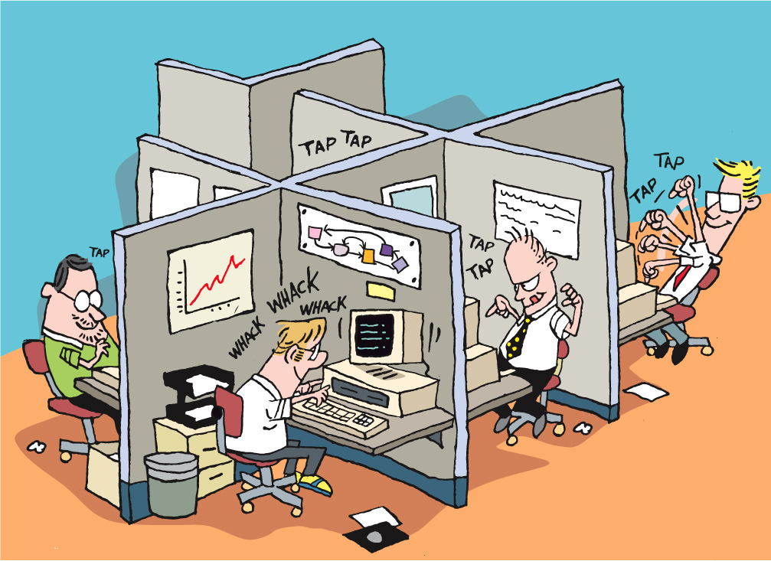
Notes:
Review
Isolated, siloed workers
Mushroom management - “keep them in the dark and feed them fertilizer – when they get big enough, can them”.
Highly ineffective
Many very smart folks decided “There must be a better way”.
----------------------------------------------------------------------------------------------------
Let’s go back again, and look at how some of these systems – practices, philosophies, and methodologies – came to be.
As we talked about at the beginning of this module, in the old days – maybe as recent as yesterday – developers (also known as programmers, software engineers, and coders) sat in their own private or semi-private spaces, working on their own, talking to their teammates infrequently. Perhaps you’ve heard of “mushroom management”? It goes “keep them in the dark and feed them fertilizer – when they get big enough, can them”.
While this is funny, it’s all to close to reality. Too many managers believe in a divide and conquer strategy, or in mushroom management, handing out just enough information to keep their staffs working. The sad thing is that this is highly ineffective.
All of those folks we just talked about a few minutes ago – Beck and Schwaber and Martin and Fowler and Cockburn and so on – all of them looked at this, mostly from being in these situations themselves, and came up with various ways to try to improve not just the lot of the developers, but also the quality of what they produced, and the speed and cost to deliver.

Slide 36
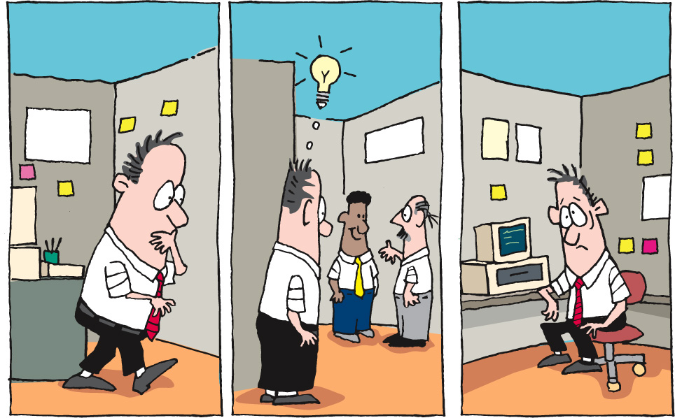
Notes:
What if I have a question?
Get up
Find the person
Have a conversation
Walk back to my space
Remember the answer
Act
Context change
Lost time
---------------------------------------------------------------------------------------------------------------------
What some of them realized was that there was a problem with isolation and infrequent communication. If I have to leave what I’m doing, find someone else, have a conversation, walk back to my work space, remember what we talked about, and put it into play, I’ve had to context switch two or three times, lost time, and communicated ineffectively. That’s just not an ideal way to work.
So these guys asked “what if?” and “how?” and experimented. They looked at where and how they sat, what their working circumstances were like, how their teams communicated internally and externally, how they managed their requirements and workflow, and more.

Slide 37
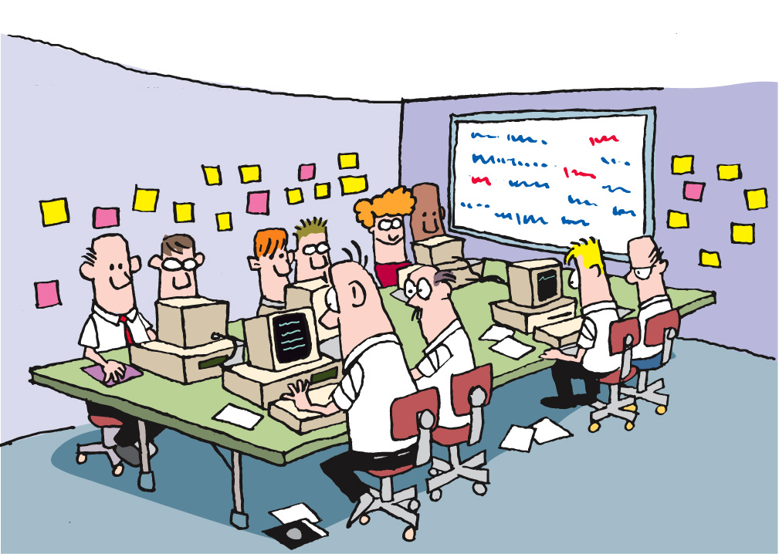
Notes:
Collocated Team
One of the most important outcomes of the C3 project at Chrysler, where Kent Beck and Ron Jeffries pioneered the practices that became eXtreme Programming, or “XP”, was the idea of a collocated team and a team room.

Slide 38
Notes:
Instead of getting up to find someone
Losing time and context
[CLICK]
Consider our previous example, where I have to get up, walk around, find someone to answer a question, go back to my office or cubicle, remember what they said… Well, there’s a lot of time and knowledge lost, and productivity is not very high. What if, when I wanted to ask someone a question, they were right there in the room with me? What if I could just ask, immediately use the answer, ask clarifying questions, all without leaving my work space?

Slide 39
Notes:
I just pick my head up and ask the question
Get an answer
Follow up question
Back to work
Productivity goes up
Quality goes up
Time goes down
What about code reviews?
Long after the code was written, tested
Change was resisted
Feedback taken as criticism
What if my reviewer was working with me?
Talking to me while I code
Pairing with me
-------------------------------------------------------------------------------------------------------------------------
The answer is that productivity goes up, the quality of the work goes up, and the time it takes goes down.
Now, let’s look at another part of this. In the old days (yes, we’re still talking about times as recent as yesterday), code reviews were a separate process, conducted with some degree of formality. They usually took place after I’d written and tested my code, when I thought I was done, and when I thought I was ready to move on. Because we had to schedule and arrange and plan the time, code reviews frequently took place some significant time after I thought I was done. Changes were resisted, and feedback was always taken as criticism.
What if code reviews were happening in real time? What if my reviewer was actually sitting right next to me, talking to me about my code, the decisions I’m making, and so on, as I’m writing my code? And what if we changed roles periodically? This is Pair Programming, and is another outcome from the C3 project, and a core practice in XP.

Slide 40
The Evolution of Approaches
Notes:
Approaches, philosophies, methodologies, practices – comprise Agile
Agile is not a single thing.
Agile is “A Manifesto for Agile Software Development”
Agile is a set of things. Practices, concepts, characteristics.
Agile is a mindset.
----------------------------------------------------------------------------------------------------
All of these approaches – call them philosophies, methodologies, and practices – comprise what we call “Agile”.
Agile is not a single thing. Agile is “A Manifesto for Agile Software Development”.
Agile is a set of things.
Agile is a mindset, a way of thinking, and a way of approaching work. From Feature-Driven Design to Scrum to XP and all the rest, it’s about the commitment to deliver more business value in the same or less time, for the same or less cost. When you read about these different schools of thought, you’ll see that they all overlap in these areas.
Of course there are differences, and it’s important to understand those differences as much as it’s important to understand the commonalities.

Slide 41
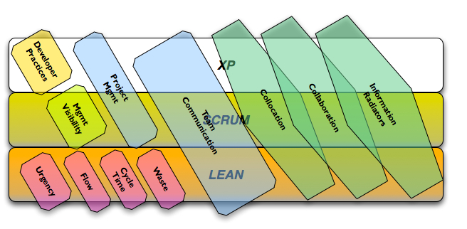
Common Philosophies and Approaches
Notes:
Areas of focus
Not necessarily missing from others
Team communication, collocation, collaboration, information radiators – common to many
Lean – waste, cycle time, flow, urgency
Scrum – management visibility
-------------------------------------------------------------------------------------------
In this graphic, you can see some of each.
For instance, team communication is common to many Agile methodologies, as are collocation, collaboration, and information radiators. While some focus on some of these more than others, it’s safe to say that they are common themes or focuses.
On the other hand, we can see that there are some significant differences. Lean focuses on waste, cycle time, flow, and urgency. While these are not specifically absent from others, they are not areas of focus.
As you can see, Scrum has more of a focus on management visibility than others, as Scrum has as its core the management of the process. Both Scrum and XP share a focus on project management, while XP has a specific focus on developer practices, which is lacking in Scrum.
This graphic represents a modest set of ideas. There are many more, of course. What is important to learn from this is that each approach may be incomplete by itself, and it’s up to each organization and project team to choose the practices and methodologies that work best for them. That is, there is not one right way, and there is no “agile in a box.” There are different areas of focus, different rationales for choosing them, and it’s up to each of us to figure out how to make the different parts and philosophies and methodologies work for us.

Slide 42
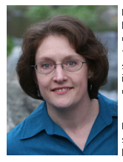

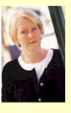
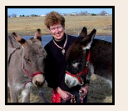
Other Agile Contributors
Notes:
And representing the women…..
Elisabeth Hendrickson
Prominent in the agile testing space
Runs a company called Quality Tree Software - Coaching
Started in 1997
In 2003 became active in the agile community
Mary Poppendieck
Co-author (with husband Tom) “Implementing Lean Software Development – From concept to cash”
Speaker and coach
Esther Derby
Offers consulting, support for agile transitions, management coaching and consulting, retrospectives, and facilitation for a variety of situations.
Co-author (with Diana Larson) “Agile Retrospectives – Making Good Teams Great”
Lisa Crispin
Co author of “Agile Testing: A Practical Guide for Testers and Agile Teams”
She specializes in showing testers and agile teams how testers can add value and how to guide development with business-facing tests. Her mission is to bring agile joy to the software testing world and testing joy to the agile development world.

Slide 43
Questions?
Agile Core
Notes:
What we’ve done……
Seen how best practices address traditional project challenges
Learned the process
Met the team

